Slide 1





Beautiful, reproducible tables in R
Zane Billings
2024-01-24

Slide 2
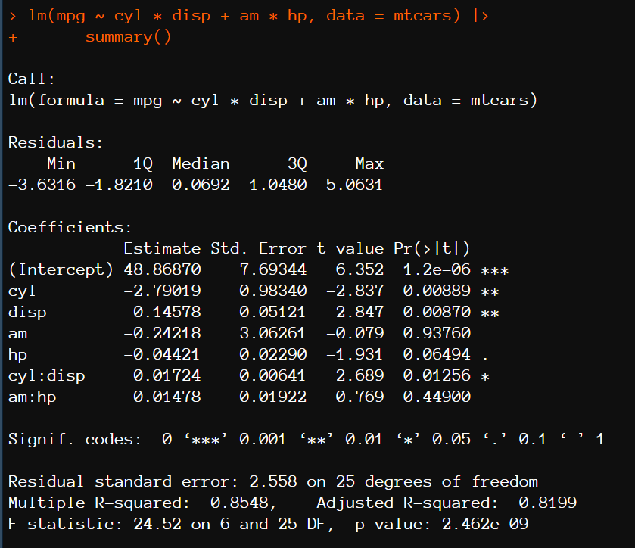
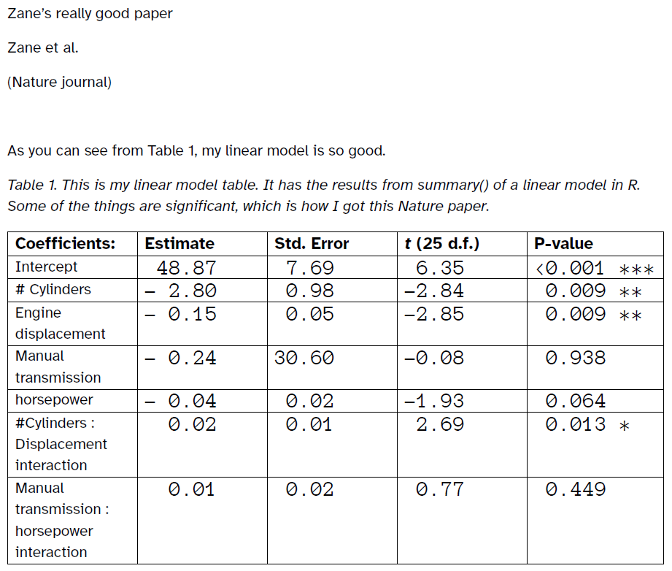

It takes 5 minutes to type the table. Why would I spend time to code it?

Slide 3



(Later that day in the office)
I am retyping the table into
Word for the 12th time today
No, I said put drat:hp interaction in the model, this doesn’t even make sense
You got it, boss
(me)

Slide 4
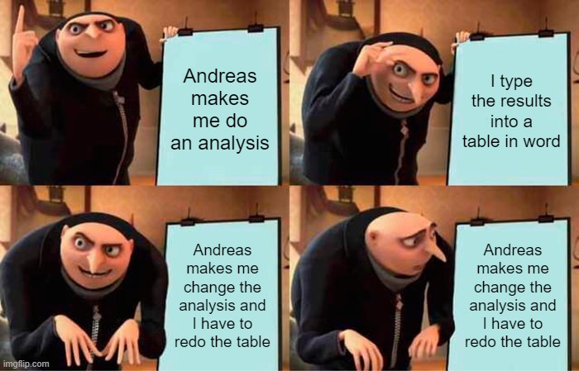

Slide 5
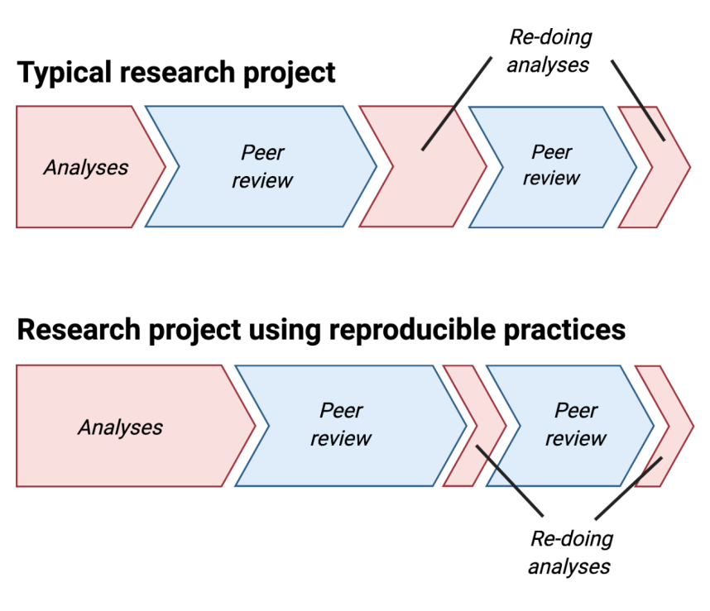
Daniel Quintana
https://osf.io/zy2pc

Slide 6
Daniel Quintana
https://osf.io/zy2pc
It takes the same amount of time, there’s just more front-end investment.

Slide 7
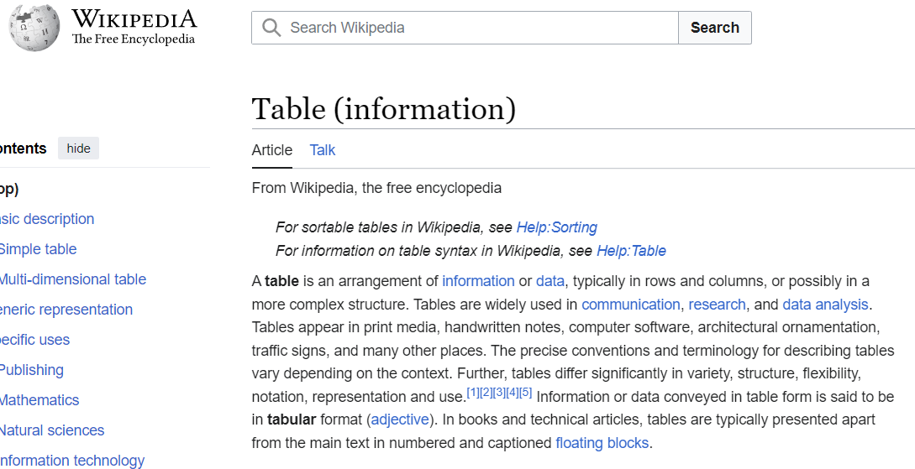
Prelude: what is a table?

Slide 8
Prelude: what is a table?

Slide 9

Prelude: what is a table?
Code

Slide 10
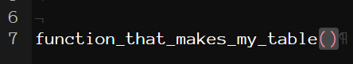




Prelude: what is a table?
etc..
Code
Display Language

Slide 11

Prelude: what is a table?
etc..
Code
Display Language
Document

Slide 12
Prelude: what is a table?
Package That Makes Your Life Easier
etc..
Code
Display Language
Document

Slide 13
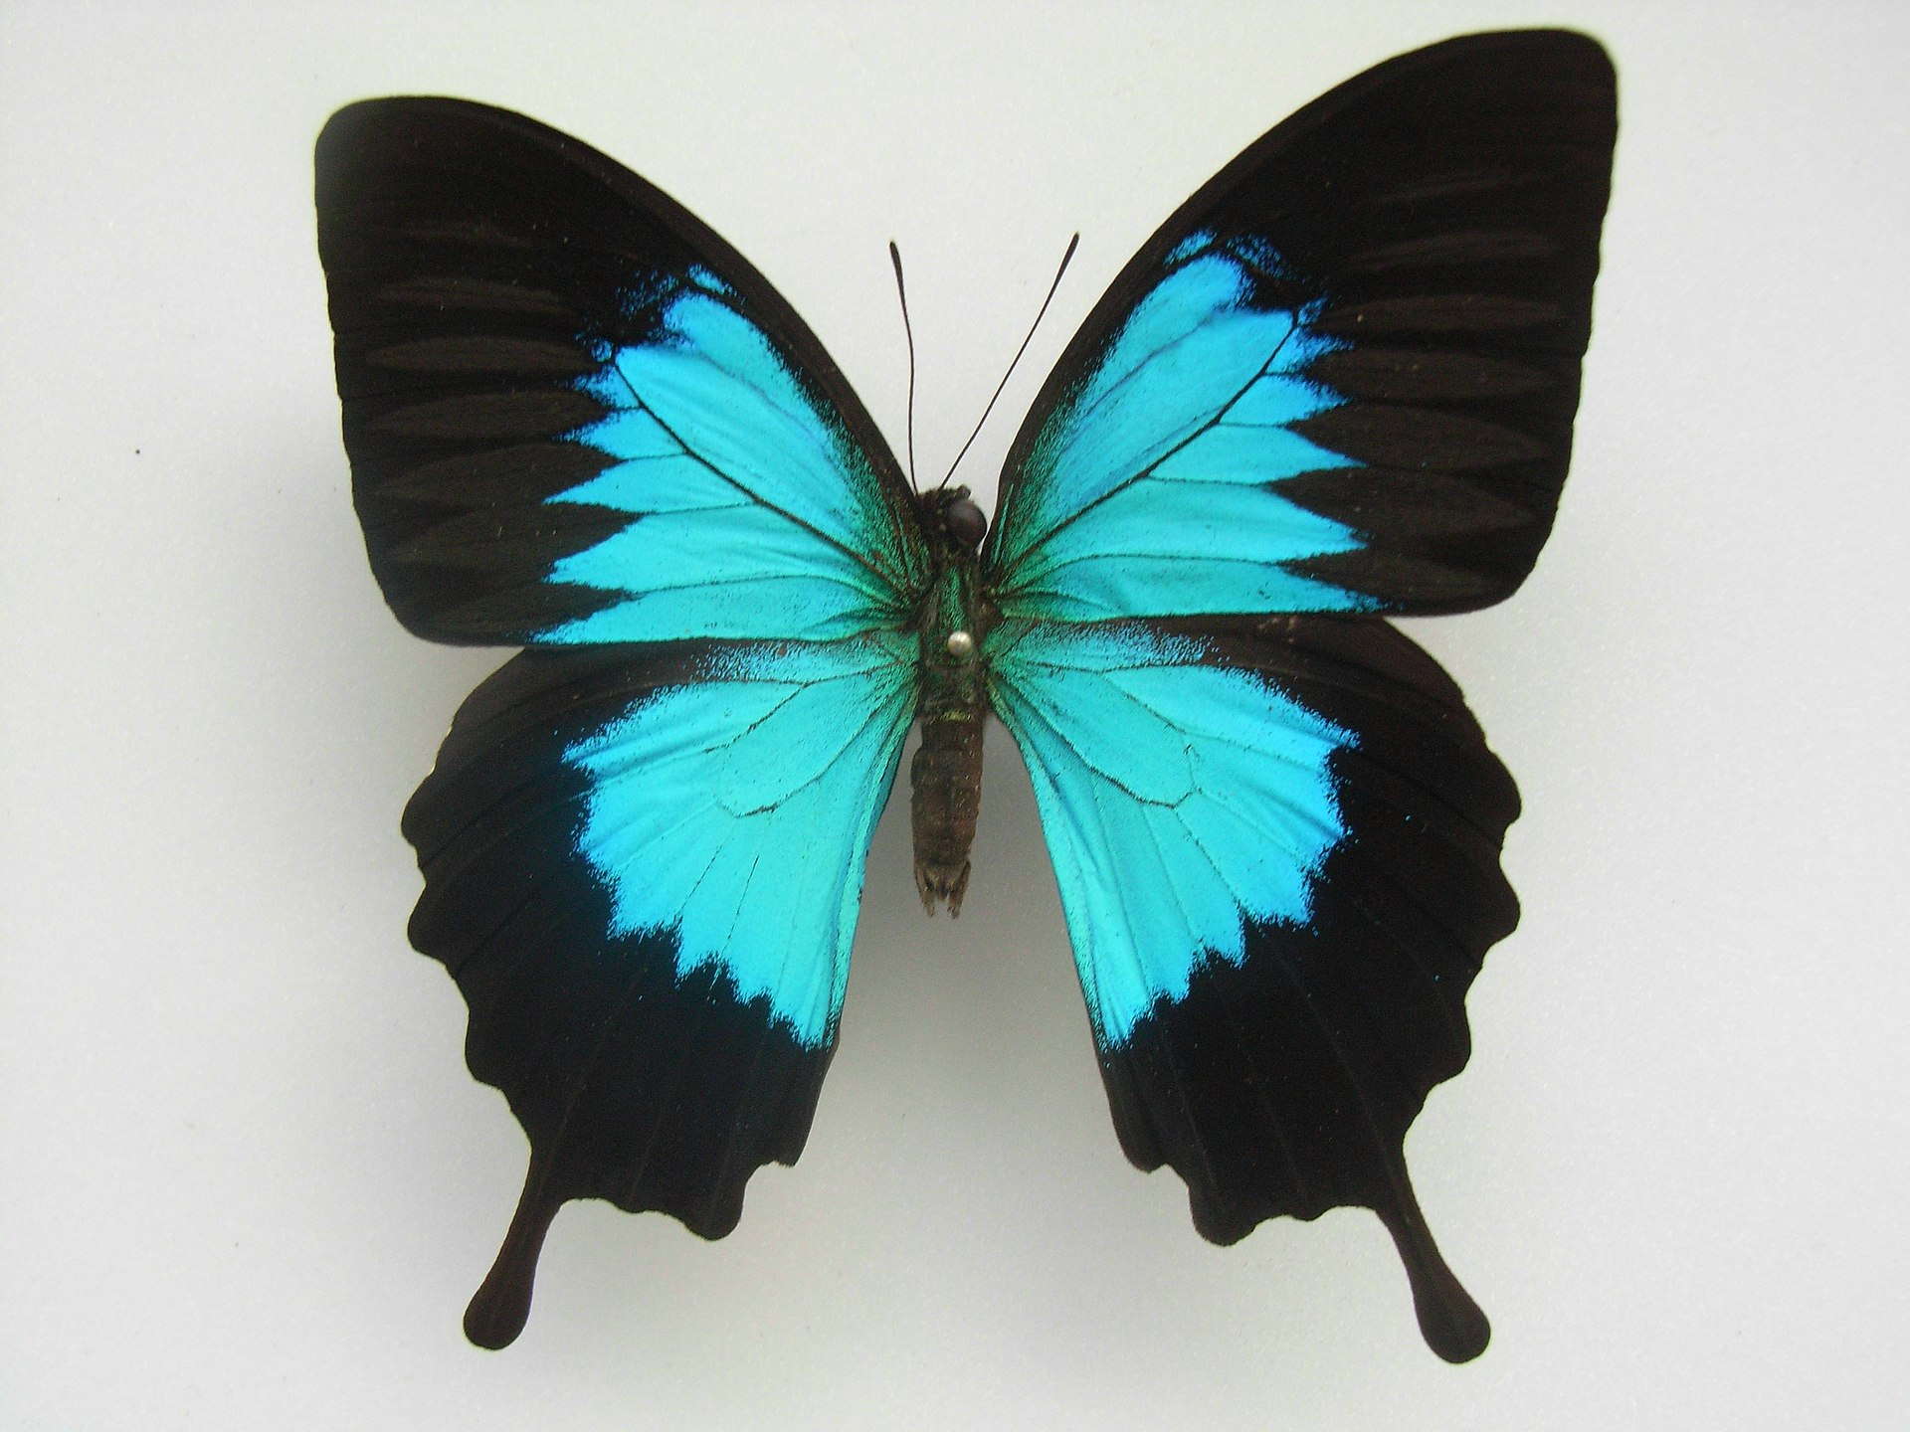
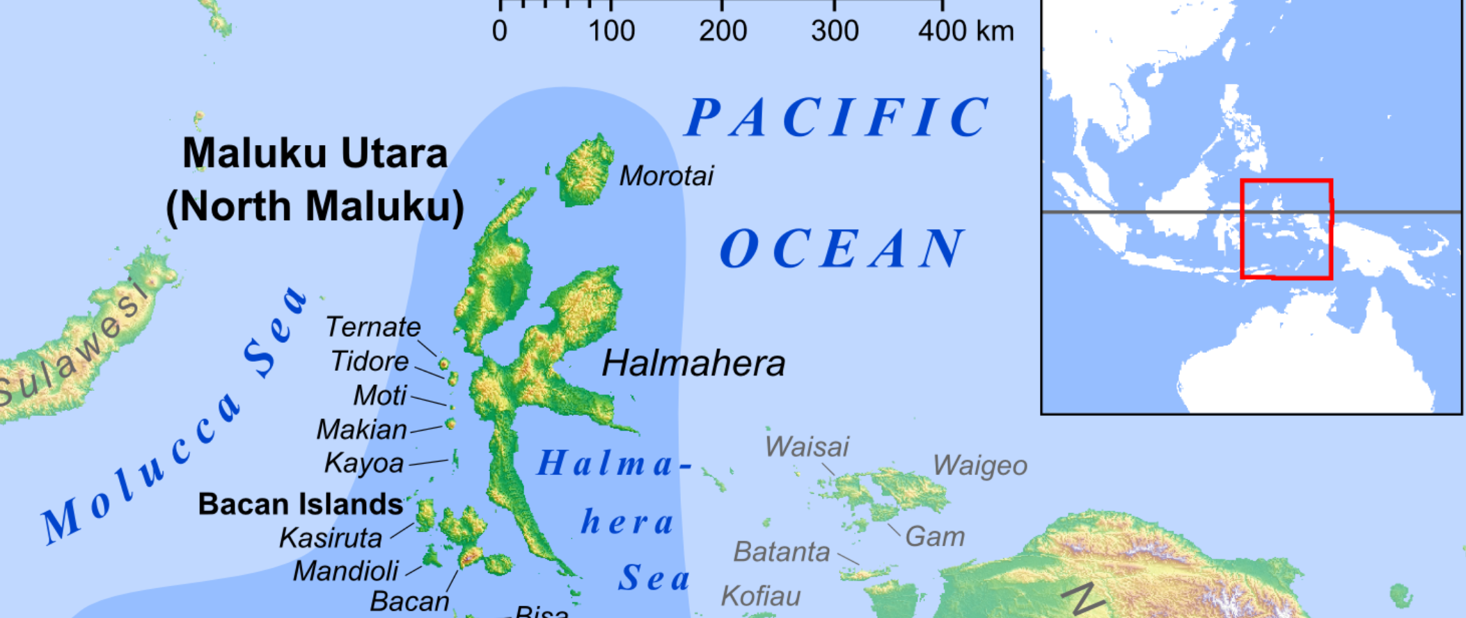

Longwing data
Papilio ulysses. (2023, July 26). In Wikipedia. https://en.wikipedia.org/wiki/Papilio_ulysses
Maluku Islands. (2024, January 5). In Wikipedia. https://en.wikipedia.org/wiki/Maluku_Islands
(me)
(ecologists)
https://www.polygon.com/animal-crossing-new-horizons-switch-acnh-guide/22757882/bug-insect-locations-times-month-day-list-critterpedia

Slide 14
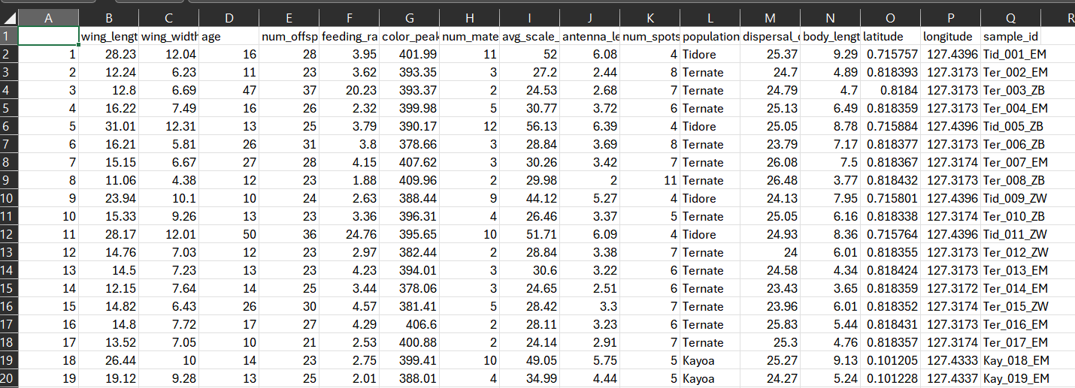
Longwing data
(100 records)

Slide 15
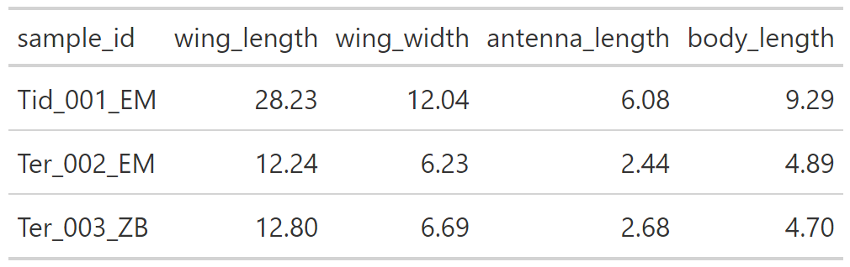
Example 1: data frame to table

Slide 16
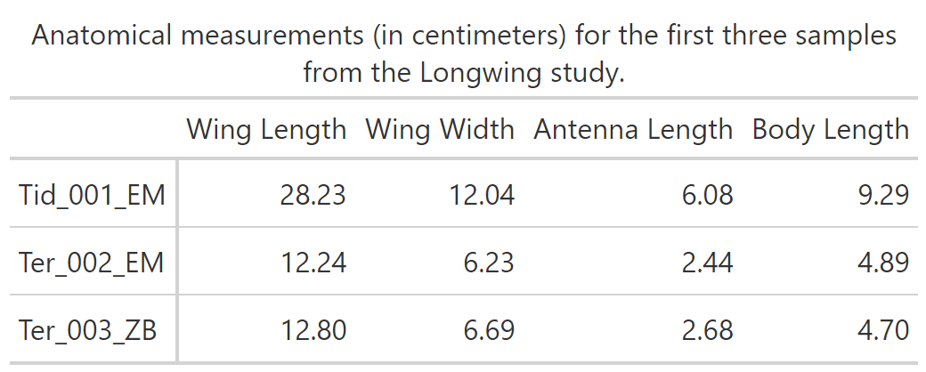
Example 2: spicing it up 🌶️

Slide 17
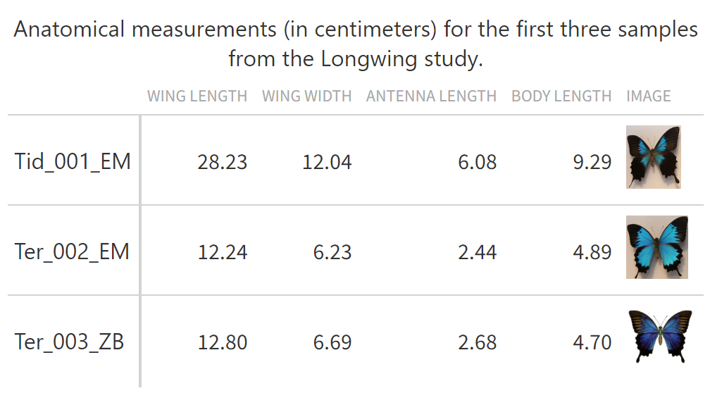
Example 2: spicing it up 🌶️🌶️🌶️

Slide 18
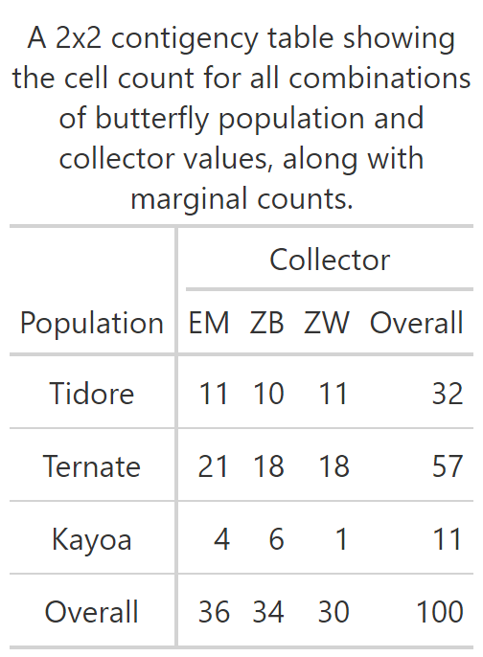
Example 3: summary statistics by hand

Slide 19
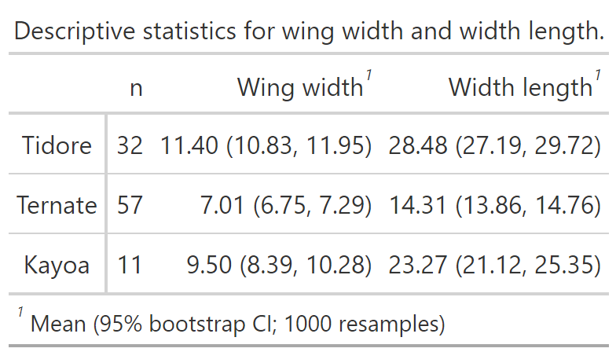
Example 3: summary statistics by hand

Slide 20
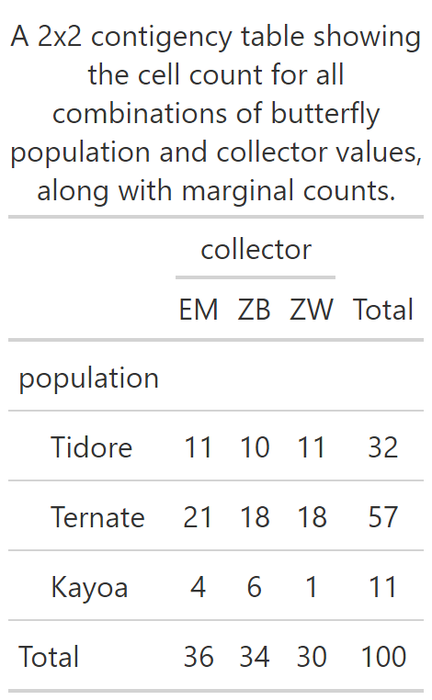
Example 4: automatic summary stats

Slide 21
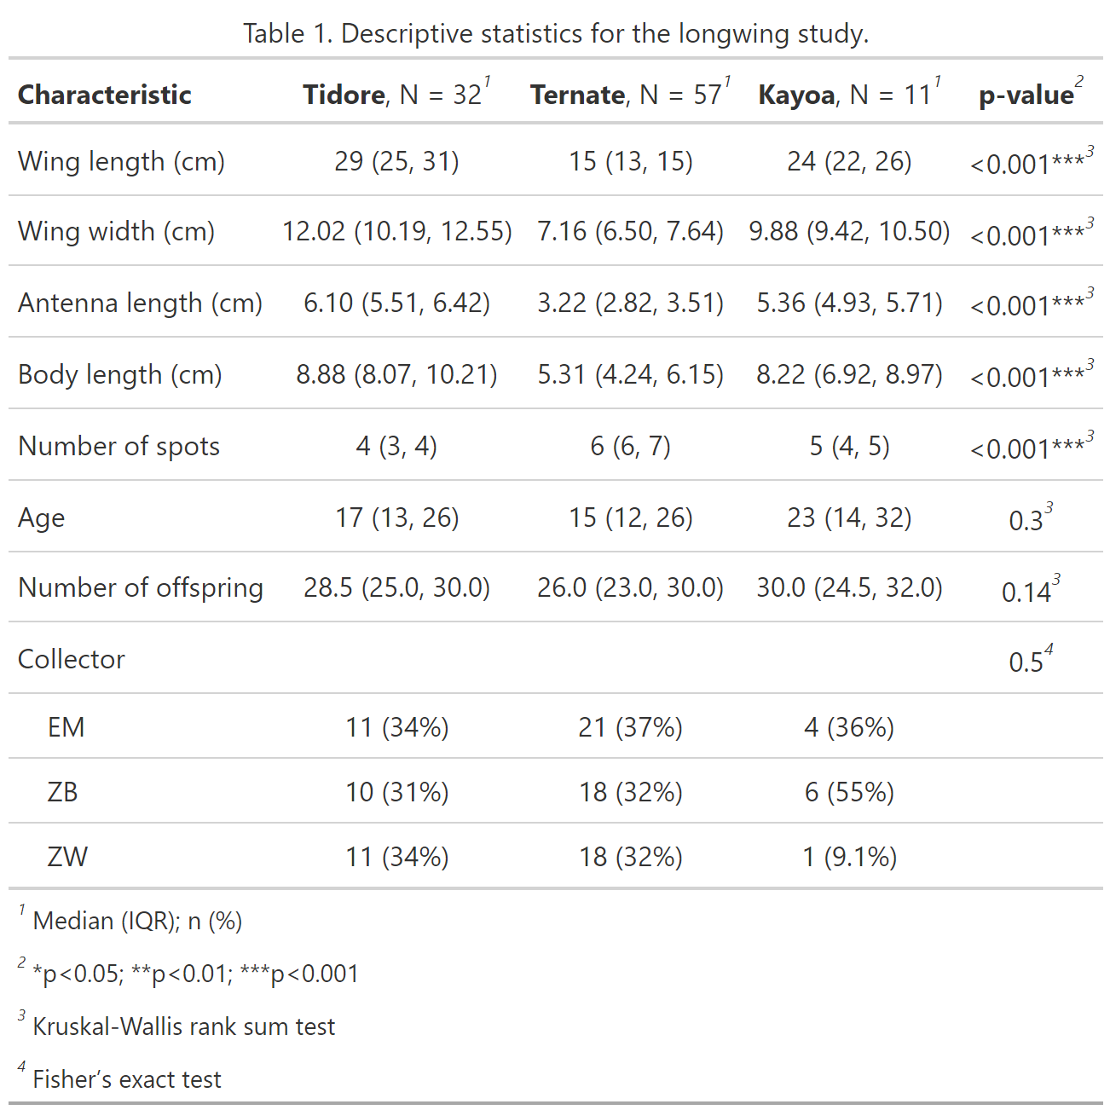
Example 4: automatic summary stats

Slide 22
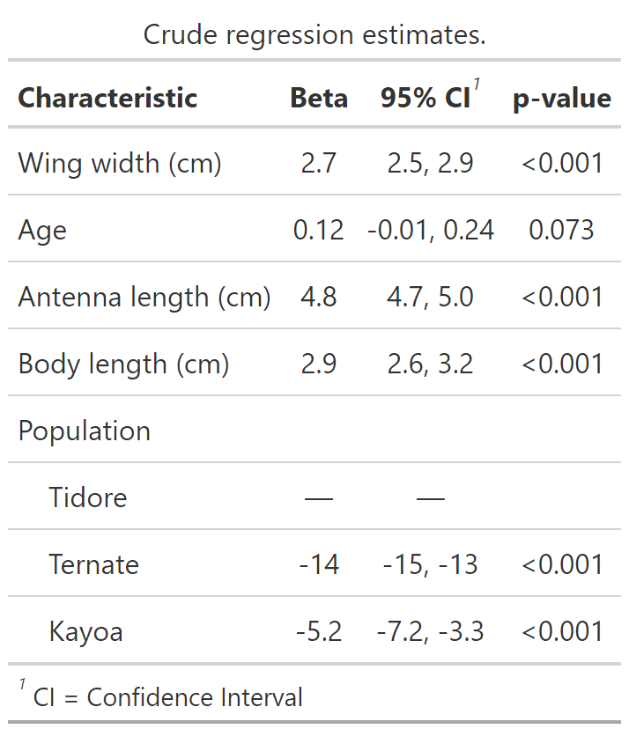
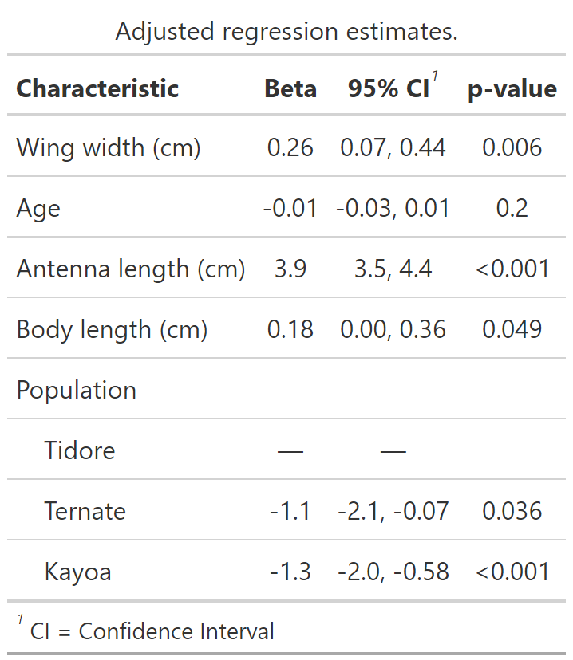
Example 5: automatic regression

Slide 23
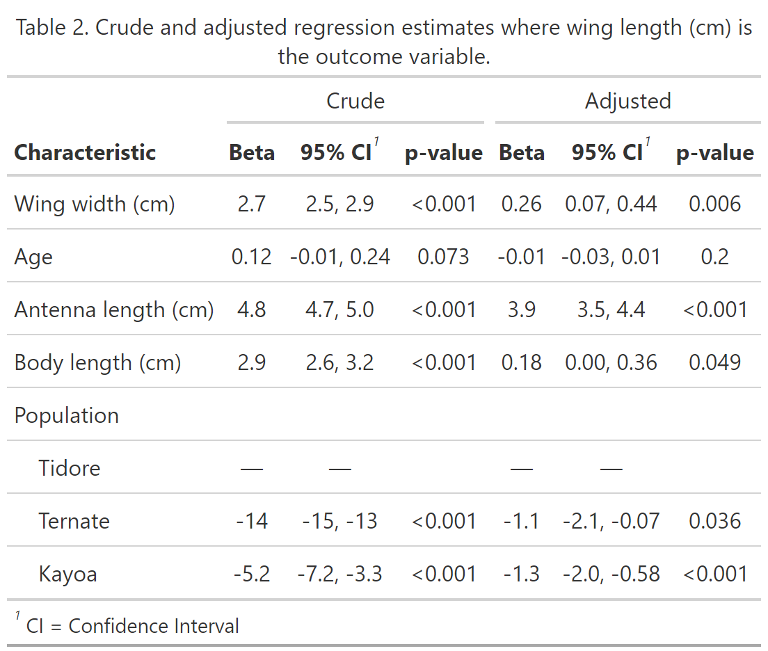
Example 5: automatic regression

Slide 24
Table 1 + Table 2…gtsummary writes your epi paper for you!

Slide 25
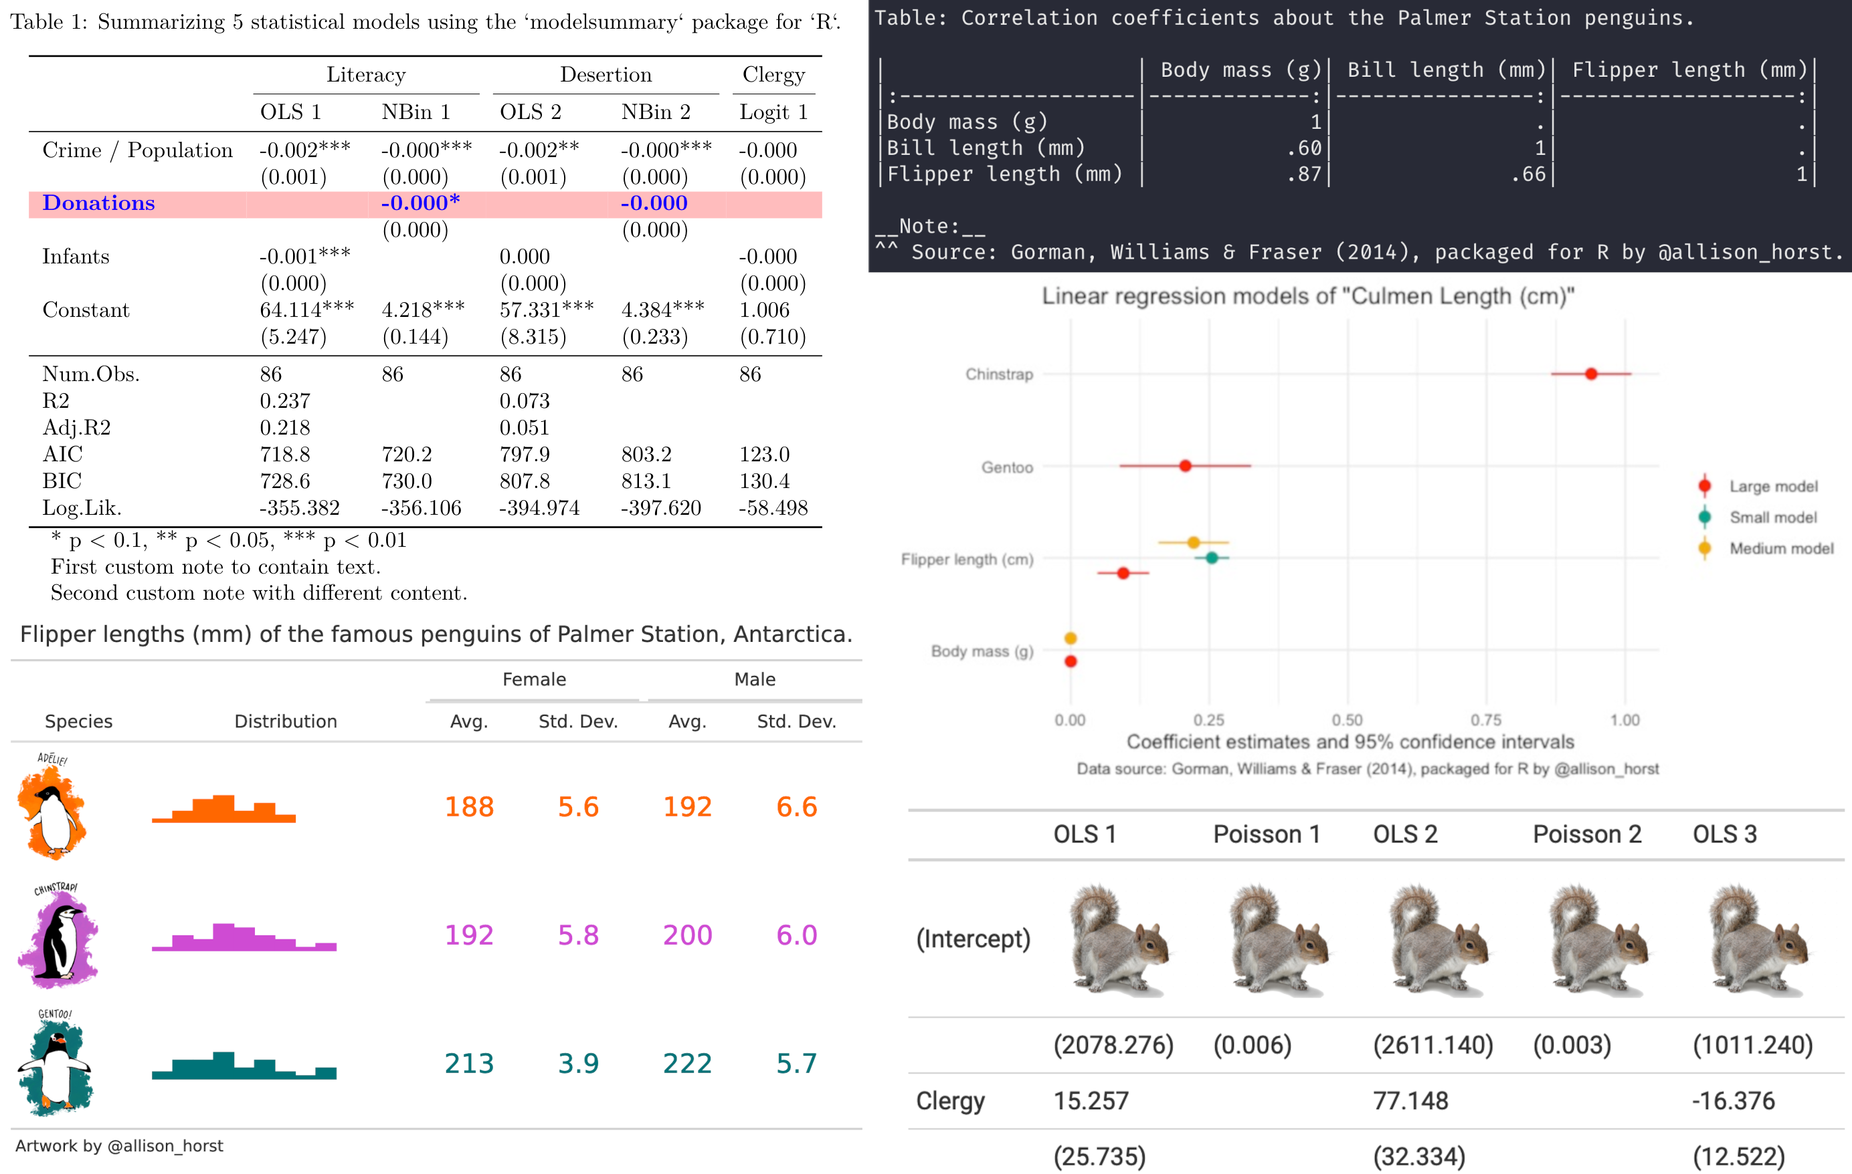
The more extensible alternative: modelsummary
https://modelsummary.com/

Slide 26
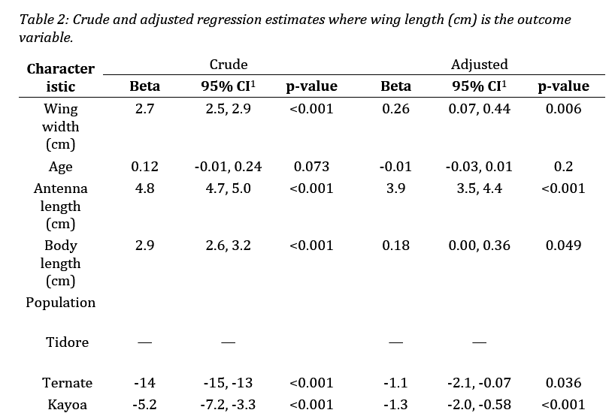
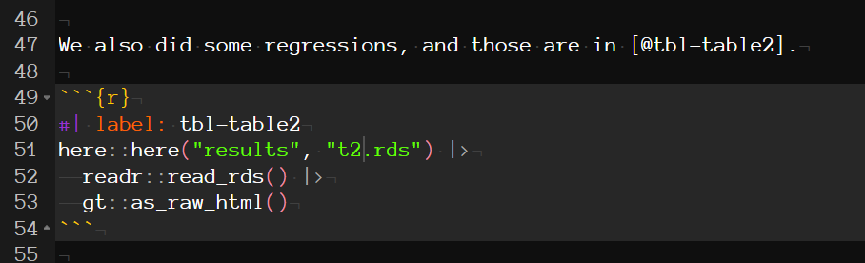
Example 7: putting it together with Quarto

Slide 27
Example 7: putting it together with Quarto
Yeah, it’s a little messed up right now due to active issues with Quarto.

Slide 28
Example 8: real life
Fortunately, those Quarto issues should get fixed eventually.
The output works fine in HTML and PDF, just not Word. If you really need Word right now, bookdown still works. (See example)
https://www.jabfm.org/content/jabfp/36/5/766.full.pdf
https://github.com/wzbillings/Patient-vs-Clinician-Symptom-Reports/tree/main/Products/Manuscript

Slide 29

(At the office after making reproducible tables in R)
Nice table! You fixed the results so fast, you must be great at statistics and typing also.
Thanks! Can I go home now?
Haha, good joke!
(me)

